Slide 1
Second-generation p-values: Introduction and Applications
Jeffrey D. Blume,
PhD
Megan H. Murray, almost PhD (July 6th defense)
and
School of Data Science
University of Virginia
Department of Biostatistics
Vanderbilt University

Slide 2
About Us
Jeffrey
?
Megan
Dissertation:
Lilly

Slide 3
Timeline
9:00am - 9:50am Slides 1-?
10 min break
10:00am - 10:30am Coding Example
10 min break
10:40am – 11:30pm Slides ?-?
10 min break
11:40am - 12:00pm Coding Example
12:00pm - 12:30pm Questions

Slide 4
Intro?
Github.com/
Make sure everyone can access it

Slide 5
Synopsis
Classical p-values are
Ubiquitous, Sacrosanct, Imperfect, Misused
Misunderstood (Significance vs. Hypothesis testing roles)
Openly debated in practice and theory
Trend toward estimation in reporting of results
Report a estimation interval (e.g. confidence interval)
Does interval contain only clinically significant values?
ASA SGPV Short Course (SGPVs)
Embody and formalize this trend
Maintain and improve error rate control
Define clinically significant before looking at the data

Slide 6
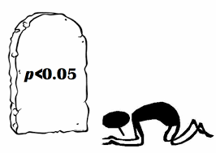
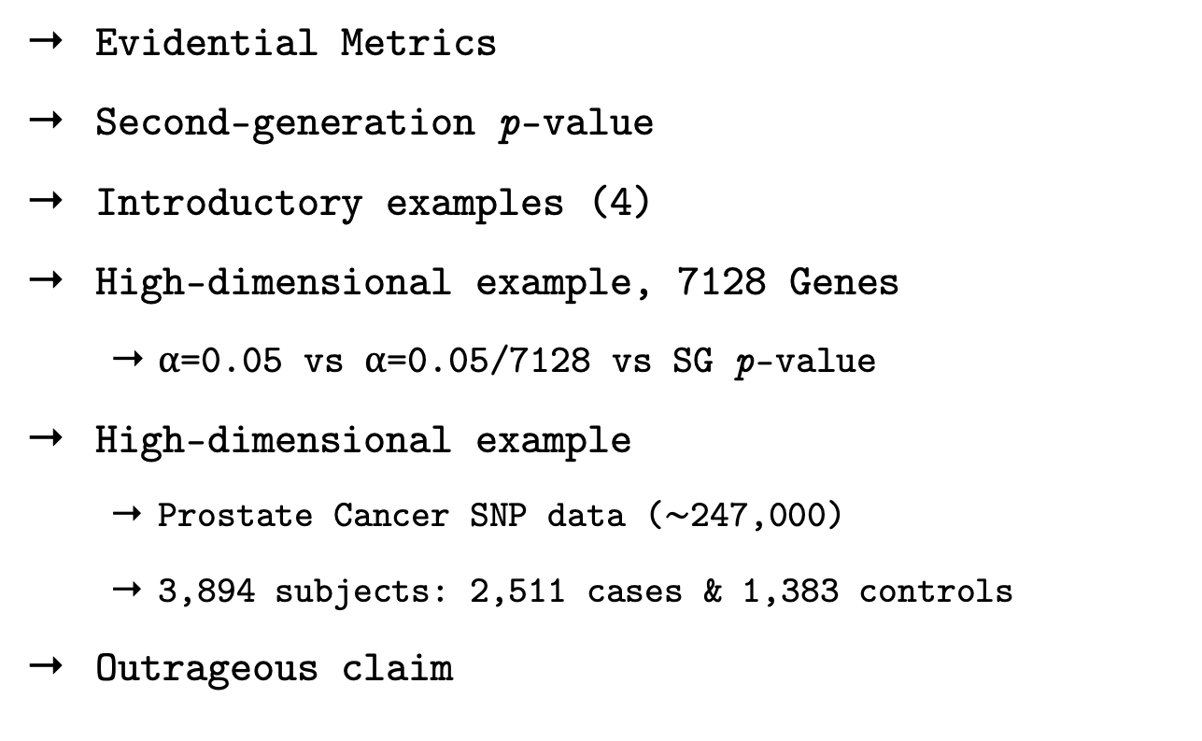
Outline
Evidential Metrics
Second-generation p-value
Introductory examples (4)
High-dimensional example, 7128 Genes
⍺=0.05 vs ⍺=0.05/7128 vs SG p-value
High-dimensional example
Prostate Cancer SNP data ($\sim$247,000)
3,894 subjects: 2,511 cases & 1,383 controls
Outrageous claim

Slide 7
Evidential metrics
Example:
Diagnostic Test
Measure of the strength evidence
Axiomatic and intuitive justification
Summary statistic, yardstick
Propensity to collect data that will yield a misleading #1
Error rates
Properties of the study design (!)
Probability that an observed #1 is misleading
False Discovery rate, False Confirmation rate
Chance that an observed result is mistaken
Properties of the observed data (!)
Positive Test
Negative Test
Sensitivity
Specificity
PPV
NPV

Slide 8
Testing
Evidential Metric | What it measures | Hypothesis Testing | Significance Testing
1 | strength of the evidence
2 | propensity for study to yield misleading evidence
3 | propensity for observed results to be misleading
Tail-area probability
(p-value)
Absent
Tail-area probability
(error rates)
Absent
misinterpret
#2
misinterpret
#1
The tail-area probability is used to measure three distinct metrics

Slide 9
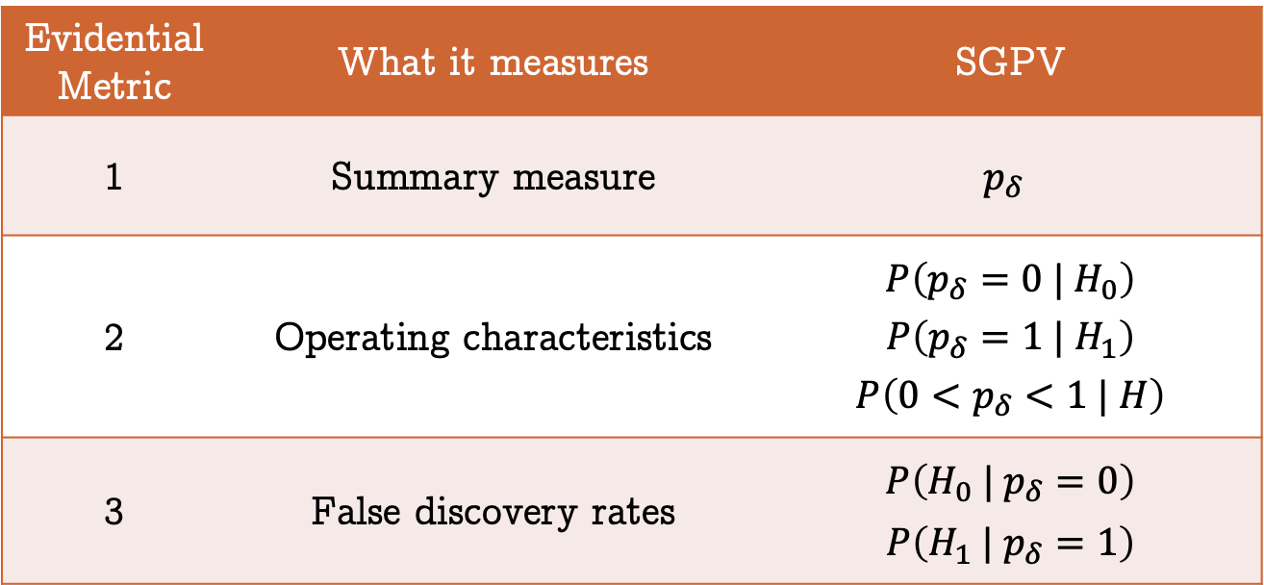
Second-generation p-value
StatisticalEvidence.com
Examine statistical properties in module 2
Retains strict error control
Evidential Metric | What it measures | SGPV
1 | Summary measure | $$p_{δ}$$
2 | Operating characteristics | $$P\left(p_{δ}=0 | H_{0}\right)$$ $$P\left(p_{δ}=1 | H_{1}\right)$$ $$P\left(0<p_{δ}<1 | H\right)$$
3 | False discovery rates | $$P\left(H_{0} | p_{δ}=0\right)$$ $$P\left(H_{1} | p_{δ}=1\right)$$

Slide 10
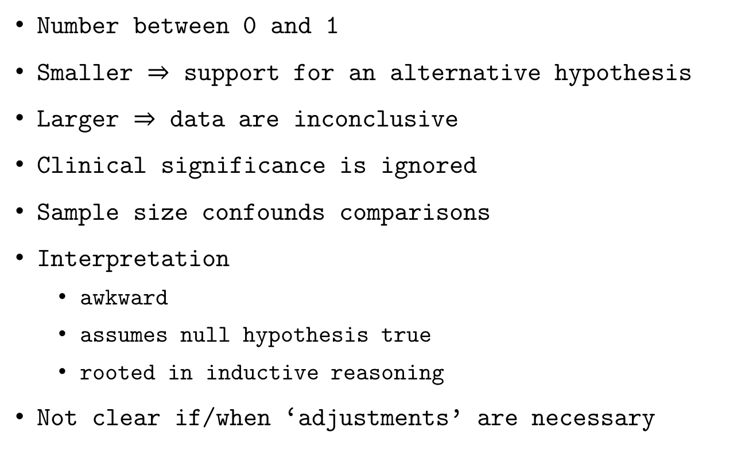
The p-value (what it is)
Number between 0 and 1
Smaller $⇒$ support for an alternative hypothesis
Larger $⇒$ data are inconclusive
Clinical significance is ignored
Sample size confounds comparisons
Interpretation
awkward
assumes null hypothesis true
rooted in inductive reasoning
Not clear if/when ‘adjustments’ are necessary
Notes:
Check transitions

Slide 11
The p-value (what it is)
2nd-generation
we want
⌃
near 0 supports alt
near 1 supports null
near ½ inconclusive
Version 2.0
Number between 0 and 1
Smaller $⇒$ support for an alternative hypothesis
Larger $⇒$ data are inconclusive
Clinical significance is ignored
Sample size confounds comparisons
Interpretation
awkward
assumes null hypothesis true
rooted in inductive reasoning
Not clear if/when ‘adjustments’ are necessary
✓
✓
support null
incorporated
✗
Fraction of data-supported
hypotheses that are null
straightforward
conditions on observed data
descriptive, summarizes
Ideally, never

Slide 12
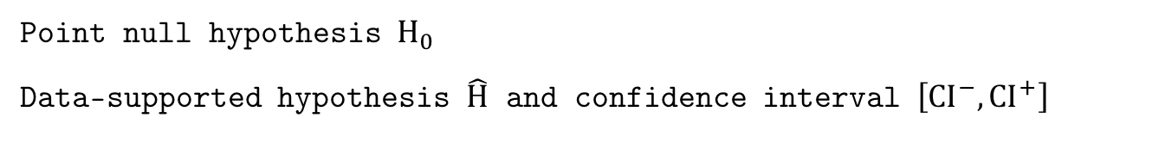
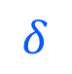
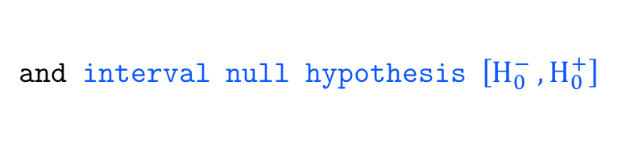
Illustration
$$δ$$
Point null hypothesis $H_{0}$
Data-supported hypothesis $\hat{H}$ and confidence interval $\left[CI^{−},CI^{+}\right]$
and interval null hypothesis $\left[H_{0}^{−} ,H_{0}^{+}\right]$

Slide 13
Illustration
Works with confidence, credible, and support intervals

Slide 14
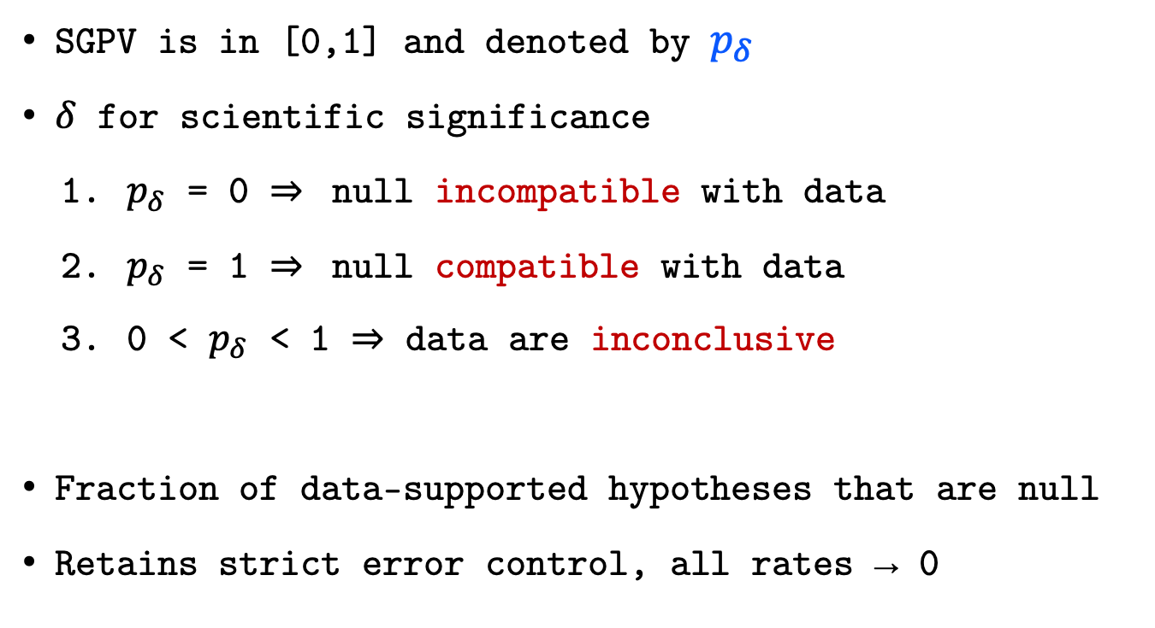
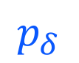
Second-generation p-value
$$p_{δ}$$
SGPV is in [0,1] and denoted by $p_{δ}$
$δ$ for scientific significance
$p_{δ}$ = 0 $⇒$ null incompatible with data
$p_{δ}$ = 1 $⇒$ null compatible with data
0 < $p_{δ}$ < 1 $⇒$ data are inconclusive
Fraction of data-supported hypotheses that are null
Retains strict error control, all rates → 0

Slide 15
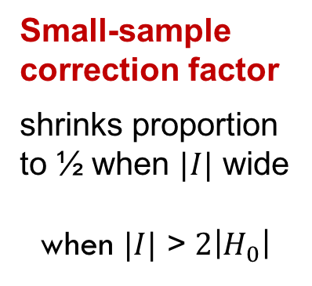
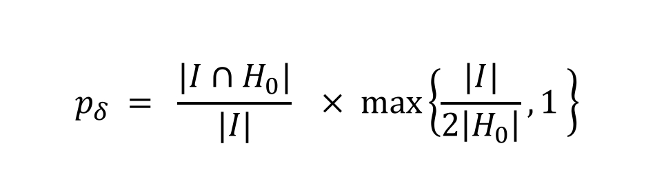
Definition
Second-generation p-value (SGPV)
$$p_{δ} = \frac{|I∩H_{0}|}{|I|}× max\left\{\frac{|I|}{2\left|H_{0}\right|},1 \right\}$$
Proportion of data-supported hypotheses that are also
null hypotheses
Small-sample correction factor
shrinks proportion to ½ when $|I|$ wide
when $|I|$ > $2\left|H_{0}\right|$

Slide 16
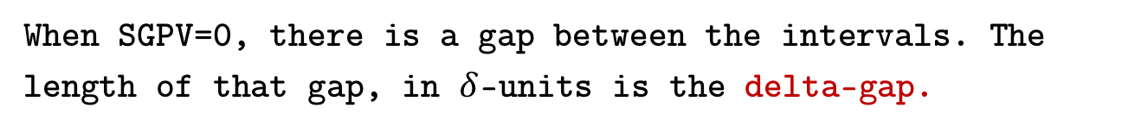
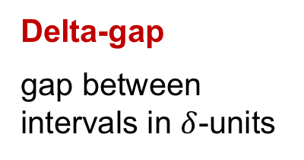
The Delta-gap
When SGPV=0, there is a gap between the intervals. The length of that gap, in $δ$-units is the delta-gap.
Delta-gap
gap between intervals in $δ$-units
Useful for ranking results when SGPV = 0

Slide 17
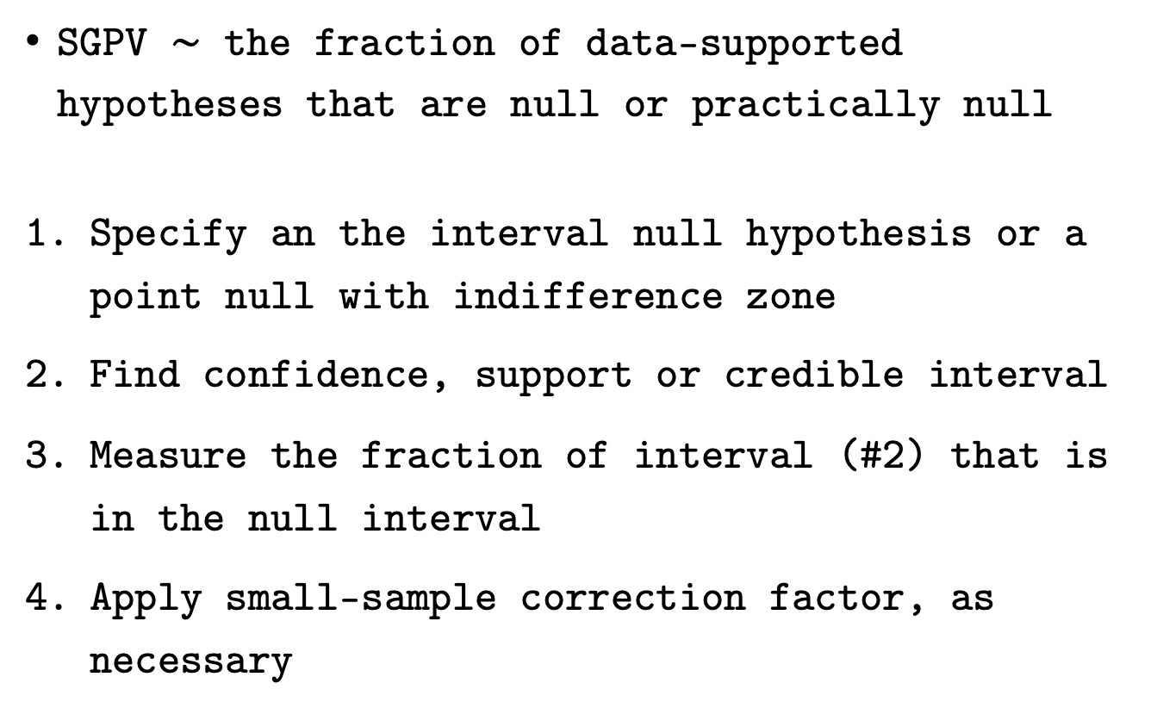
Steps
SGPV $\sim$ the fraction of data-supported hypotheses that are null or practically null
Specify an the interval null hypothesis or a point null with indifference zone
Find confidence, support or credible interval
Measure the fraction of interval (#2) that is in the null interval
Apply small-sample correction factor, as necessary

Slide 18
Systolic Blood Pressure
SBP is reported to the nearest 2 mmHg
Null Hypothesis: mean SPB is 145 mmHg
Interval Null hypothesis: mean is 143 to 147 mmHg
Results from 8 mock studies

Slide 19
p-value | Max P | 2nd Gen P
1 | 1 | 1

Slide 20
p-value | Max P | 2nd Gen P
1 | 1 | 1
0.0455 | 1 | 1

Slide 21
p-value | Max P | 2nd Gen P
1 | 1 | 1
0.0455 | 1 | 1
0.4237 | 1 | 0.7041

Slide 22
p-value | Max P | 2nd Gen P
1 | 1 | 1
0.0455 | 1 | 1
0.4237 | 1 | 0.7041
1 | 1 | 0.5

Slide 23
p-value | Max P | 2nd Gen P
1 | 1 | 1
0.0455 | 1 | 1
0.4237 | 1 | 0.7041
1 | 1 | 0.5
0.0455 | 1 | 0.5

Slide 24
p-value | Max P | 2nd Gen P
1 | 1 | 1
0.0455 | 1 | 1
0.4237 | 1 | 0.7041
1 | 1 | 0.5
0.0455 | 1 | 0.5
<0.0001 | 0.3173 | 0.2499

Slide 25
p-value | Max P | 2nd Gen P
1 | 1 | 1
0.0455 | 1 | 1
0.4237 | 1 | 0.7041
1 | 1 | 0.5
0.0455 | 1 | 0.5
<0.0001 | 0.3173 | 0.2499
<0.0001 | 0.0455 | 0

Slide 26
p-value | Max P | 2nd Gen P
1 | 1 | 1
0.0455 | 1 | 1
0.4237 | 1 | 0.7041
1 | 1 | 0.5
0.0455 | 1 | 0.5
<0.0001 | 0.3173 | 0.2499
<0.0001 | 0.0455 | 0
<0.0001 | <0.0001 | 0

Slide 27
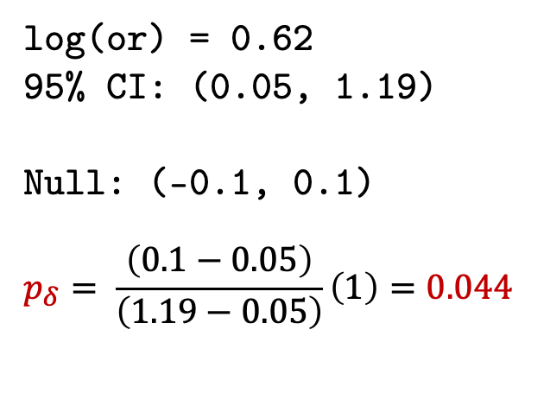
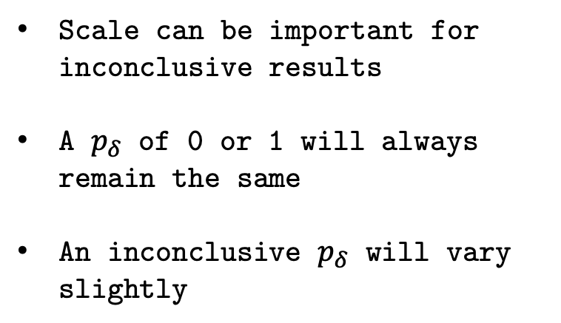
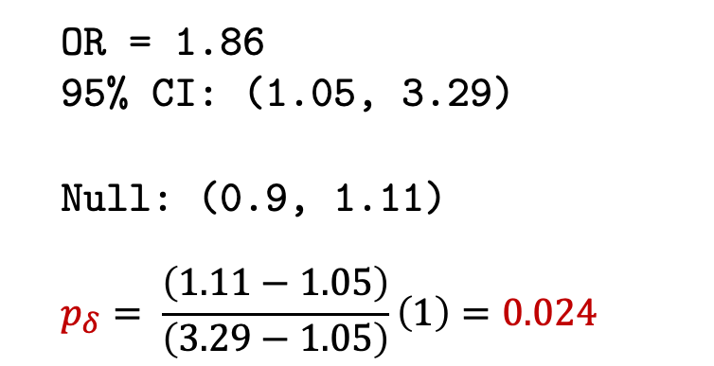
2x2 Tables & Odds Ratios
Exposure | Outcome
 | No | Yes
Exposed | 35 | 65
Unexposed | 50 | 50
OR = 1.86
95% CI: (1.05, 3.29)
Null: (0.9, 1.11)
$$p_{δ}= \frac{\left(1.11−1.05\right)}{\left(3.29−1.05\right)}\left(1\right)=0.024$$
Scale can be important for inconclusive results
A $p_{δ}$ of 0 or 1 will always remain the same
An inconclusive $p_{δ}$ will vary slightly
log(or) = 0.62
95% CI: (0.05, 1.19)
Null: (-0.1, 0.1)
$$p_{δ}= \frac{\left(0.1−0.05\right)}{\left(1.19−0.05\right)}\left(1\right)=0.044$$

Slide 28
Bone Marrow in Acute Myocardial Infarction (BOMAMI)
European Heart Journal (2011)
Randomized multicenter study
Intracoronary administration of autologous bone marrow cells (BMCs) can lead to a modest improvement in cardiac function
Aim: Evaluate the effect of BMC therapy on myocardial viability in patients with decreased left ventricular ejection fraction (LVEF) after acute myocardial infarction (AMI)
Notes:
Myocardial viability improved in 16/47 (34%) patients in the BMC group compared with 7/43 (16%) in the control group (P = 0.06).
http://eurheartj.oxfordjournals.org/content/32/14/1748 Figure 3

Slide 29
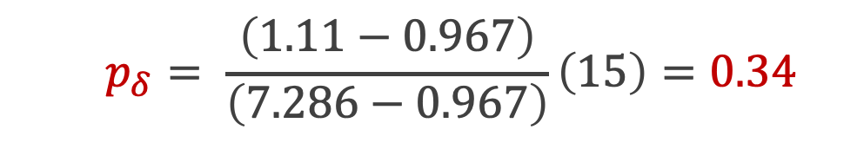
BONAMI Trial
Null Interval: (0.9, 1.11)
$$p_{δ}= \frac{\left(1.11−0.967\right)}{\left(7.286−0.967\right)}\left(15\right)=0.34$$
Notes:
Myocardial viability improved in 16/47 (34%) patients in the BMC group compared with 7/43 (16%) in the control group (P = 0.06).
http://eurheartj.oxfordjournals.org/content/32/14/1748 Figure 3

Slide 30
Effect Measures for BOMAMI
 | BMC | Control | Total
Gain | 16 | 7 | 23
No Gain | 31 | 36 | 67
Total | 47 | 43 | 90
Risk | 0.34 | 0.16
Null Hypotheses
OR/RR: (0.9, 1.11)
RD: (-0.05, 0.05)
 | Estimate | CI Lower | CI Upper | SGPV
Odds Ratio | 2.65 | 0.967 | 7.286 | 0.34
Risk Ratio | 2.09 | 0.953 | 4.589 | 0.37
Risk Difference | 0.18 | 0.003 | 0.352 | 0.24

Slide 31
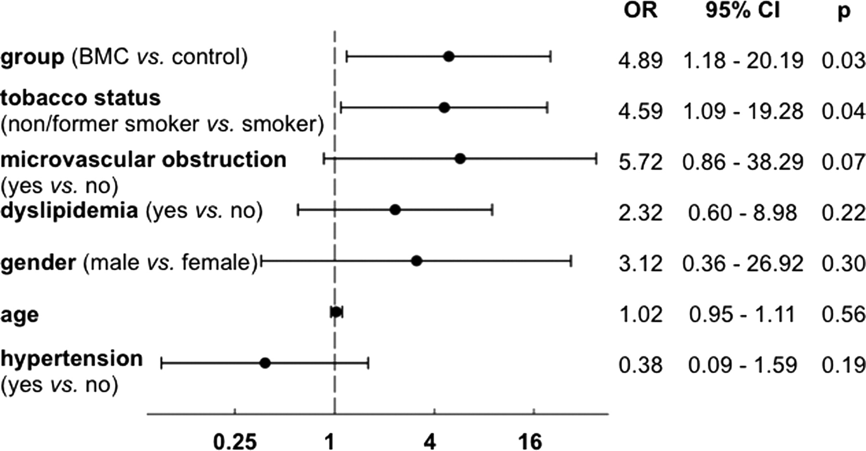
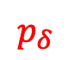
BONAMI Trial
Logistic Regression
with Null Zone: (0.9, 1.11)
$$p_{δ}$$
0
0.048
0.5
0.5
0.5
1
0.5
Notes:
Myocardial viability improved in 16/47 (34%) patients in the BMC group compared with 7/43 (16%) in the control group (P = 0.06).
http://eurheartj.oxfordjournals.org/content/32/14/1748 Figure 3

Slide 32
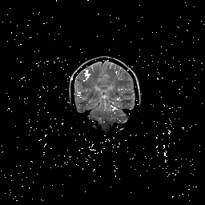
Setting interval null
Before analyzing data (!)
Measurement error
Subject matter knowledge
Impact of findings
Community standard
Get creative (fMR example)
Width not critical, buffer
The Atlantic salmon imaging saga

Slide 33
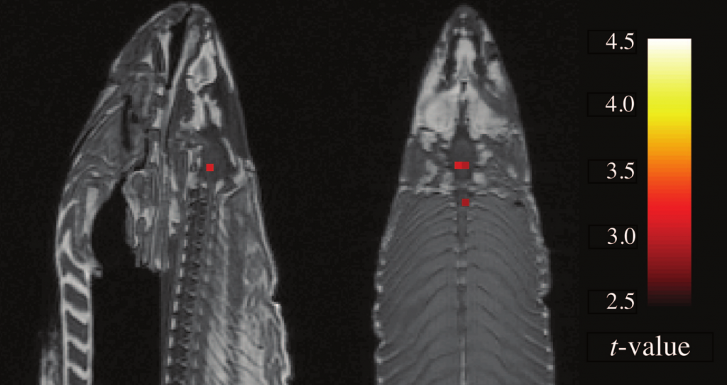
"Sagittal and axial images; t(131) > 3.15, p(uncorrected) < 0.001, 3 voxel extent threshold. Two clusters were observed in the salmon central nervous system. One cluster…in the medial brain cavity and another…in the upper spinal column."
From Bennett et. al., 2010, JSUR 1:1 1-5. 8064 total voxels; 16 identified.

Slide 35
Lung Cancer Survival
Survival time in patients with advanced lung cancer (days)
Potential for gender dissimilarities
Trial by North Central Cancer Treatment Group (1994)

Slide 36
Notes:
Logrank p-value is ~p=0.0013 I think. Discuss weighted average and what a log-rank statistic is.
What does it mean for two curves to be different?

Slide 37
Notes:
Logrank p-value is ~p=0.0013 I think. Discuss weighted average and what a log-rank statistic is.
What does it mean for two curves to be different?

Slide 38
Leukemia gene expression
Classifying acute leukemia by precursors (Golub 1999, Science)
7128 genes ; 72 patients (47 ALL and 25 AML)
Affymetrix chip collected expression levels
Goal: Identify `interesting' genes whose expression levels differ between All and AML subjects.
Looking for fold changes of 2 or more

Slide 39
7128 test-statistics

Slide 41
Notes:
10^(0.3)=2 ; so fold changes of at least 2

Slide 42
Notes:
10^(0.3)=2 ; so fold changes of at least 2

Slide 44
p-value

Slide 45
p-value

Slide 46
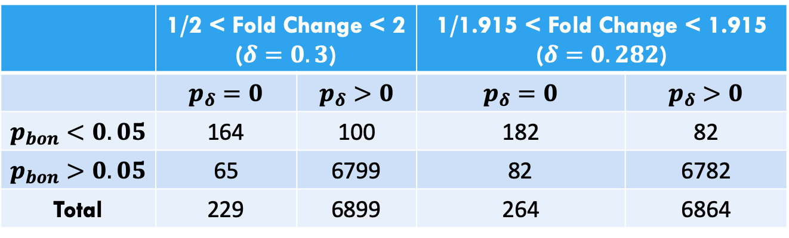
Cross-Tabulation of Leukemia Results
Bonferroni vs ASA SGPV Short Course
 | 1/2 < Fold Change < 2 ($δ=0.3$) |  | 1/1.915 < Fold Change < 1.915 ($δ=0.282$)
 | $p_{δ}=0$ | $p_{δ}>0$ | $p_{δ}=0$ | $p_{δ}>0$
$p_{bon}<0.05$ | 164 | 100 | 182 | 82
$p_{bon}>0.05$ | 65 | 6799 | 82 | 6782
Total | 229 | 6899 | 264 | 6864

Slide 47
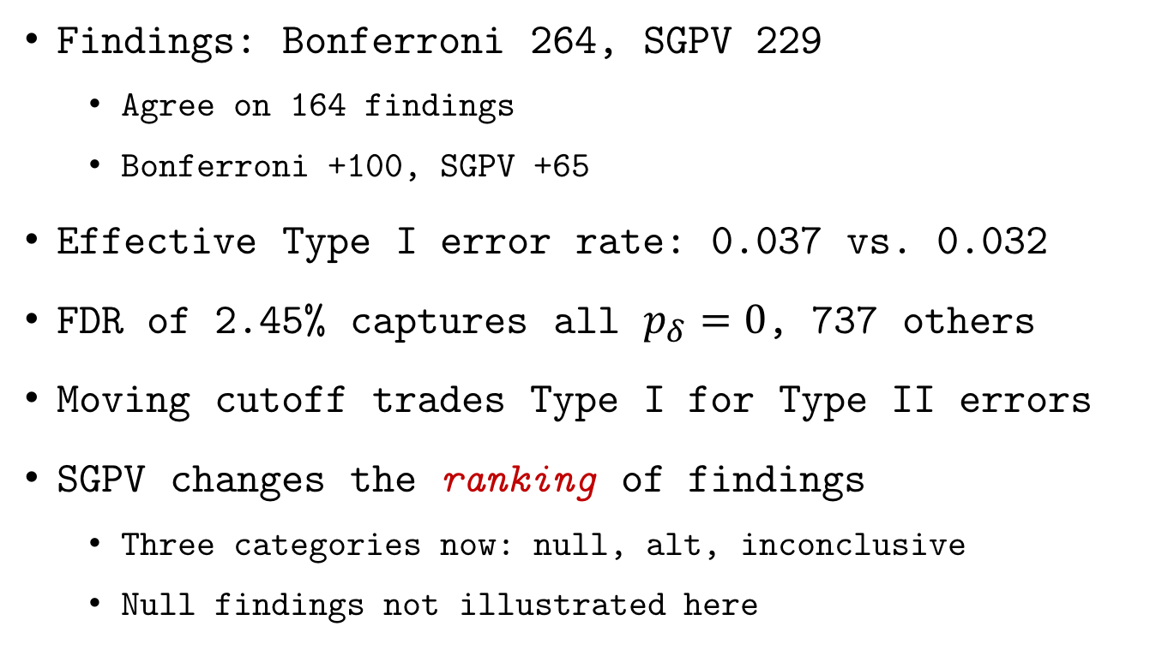
Leukemia study findings
Some SGPV findings
have a priori published validation
Findings: Bonferroni 264, SGPV 229
Agree on 164 findings
Bonferroni +100, SGPV +65
Effective Type I error rate: 0.037 vs. 0.032
FDR of 2.45% captures all $p_{δ}=0$, 737 others
Moving cutoff trades Type I for Type II errors
SGPV changes the ranking of findings
Three categories now: null, alt, inconclusive
Null findings not illustrated here

Slide 52
Prostate Cancer SNPs
International Consortium for Prostate Cancer Genetics (Schaid and Chang 2055; ICPCG 2018)
3,894 subjects: 2,511 cases & 1,383 controls
247,000 single-nucleotide polymorphisms (SNPs) from Chromosome 6
Goal: Identify `interesting’ SNPs potentially associated with prostate cancer
Looking for odds ratios of <0.9 or >1.11

Slide 53
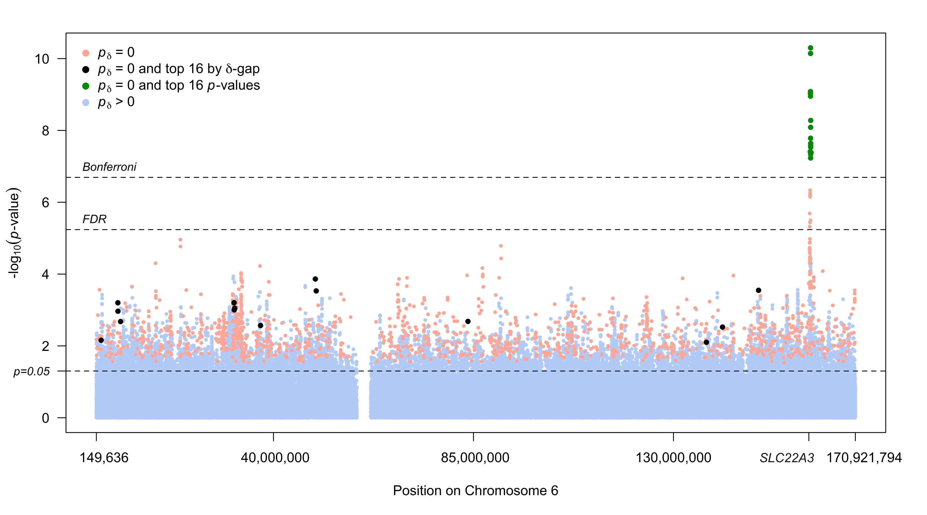
Notes:
10^(0.3)=2 ; so fold changes of at least 2

Slide 54
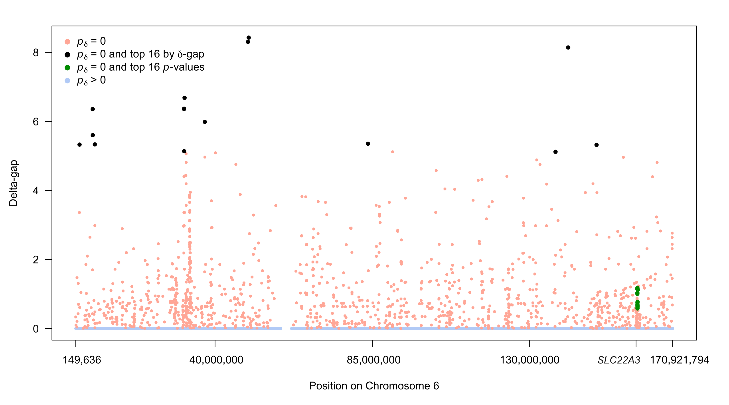
Notes:
10^(0.3)=2 ; so fold changes of at least 2

Slide 55
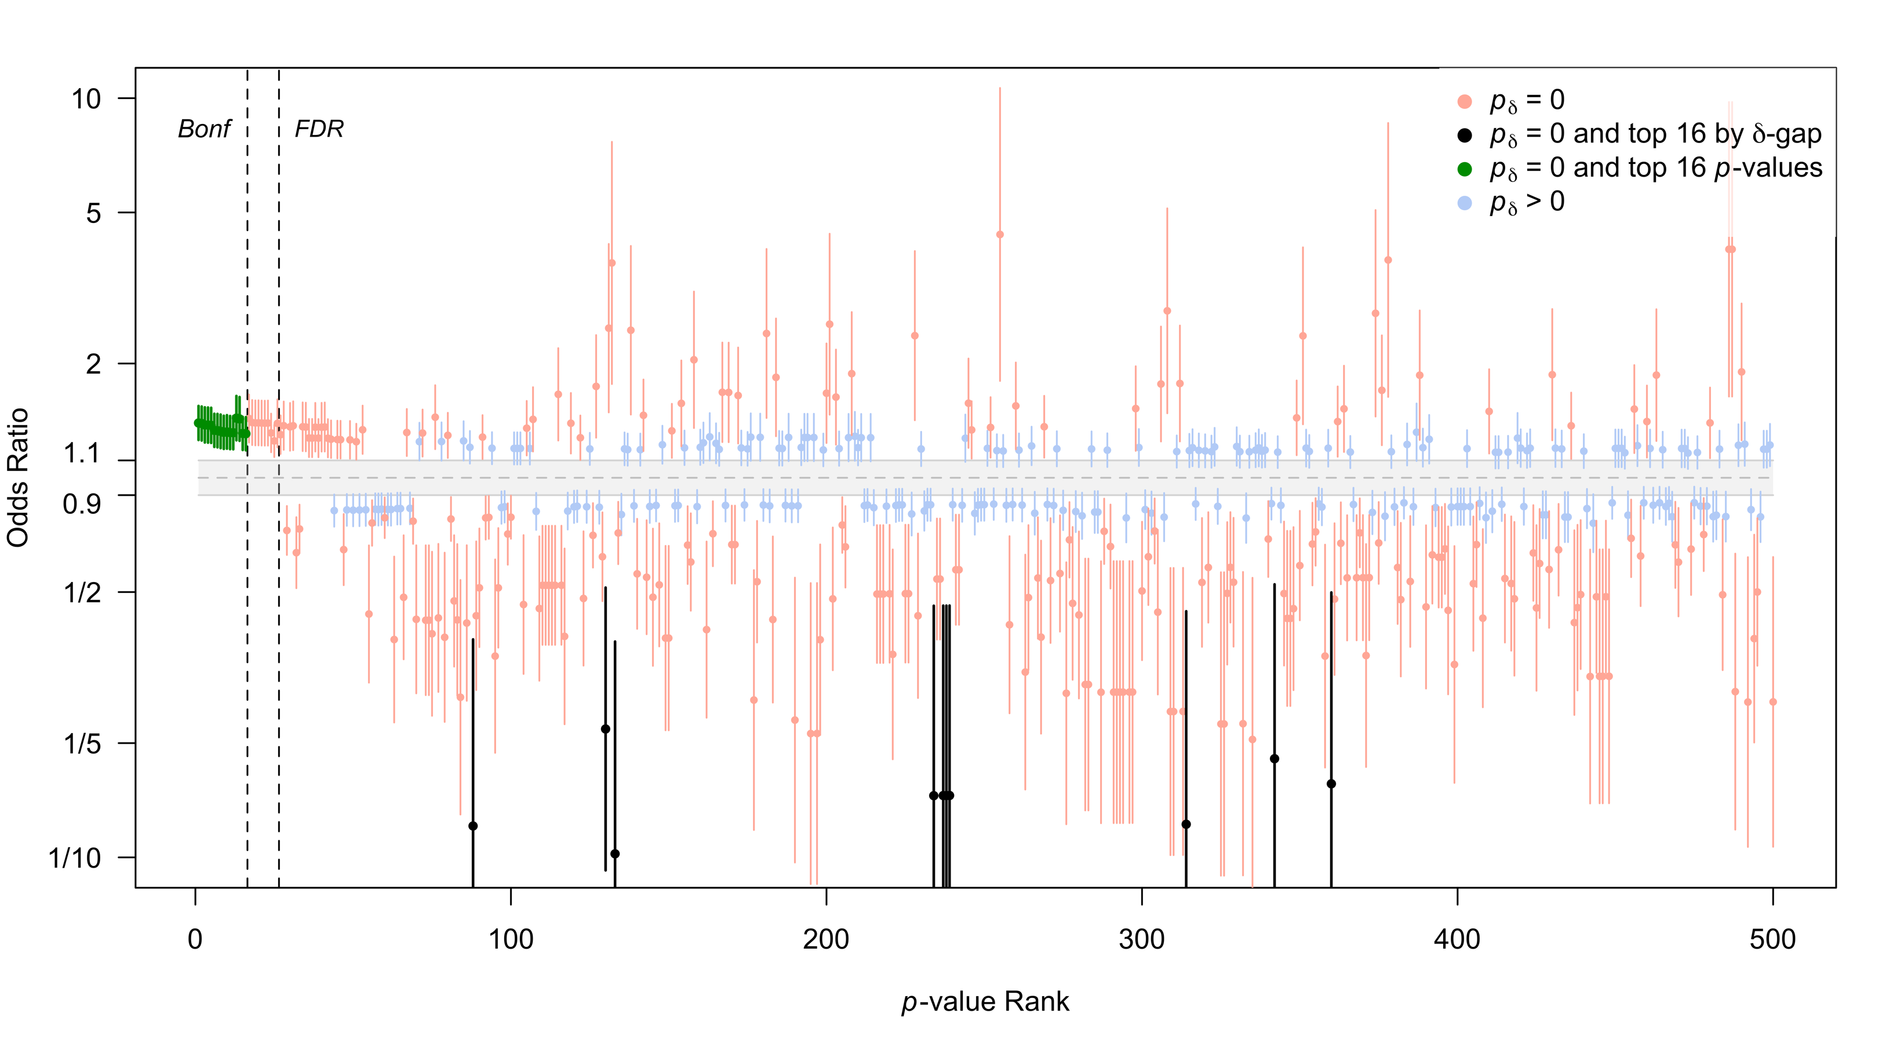

Slide 56
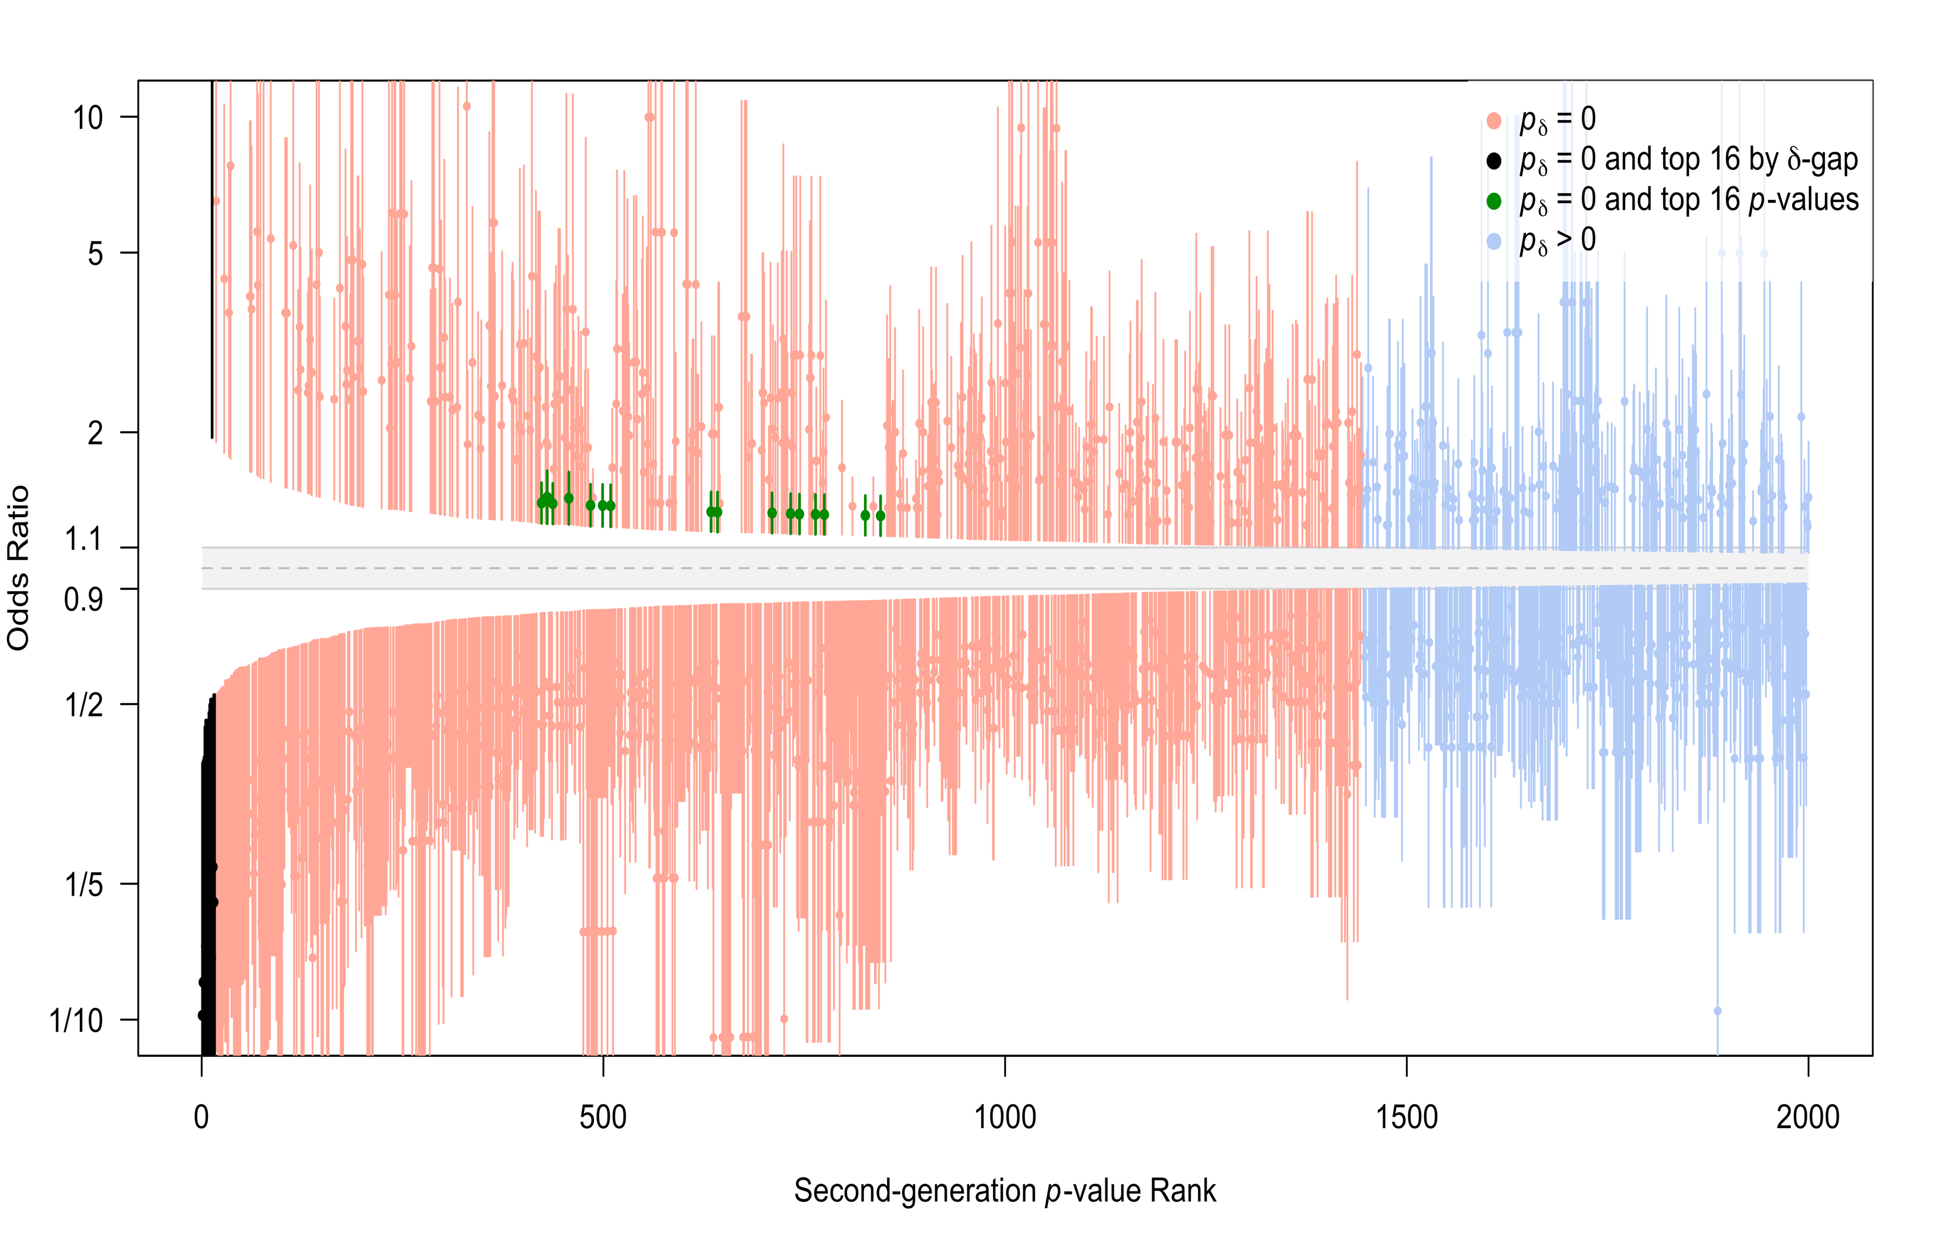

Slide 57
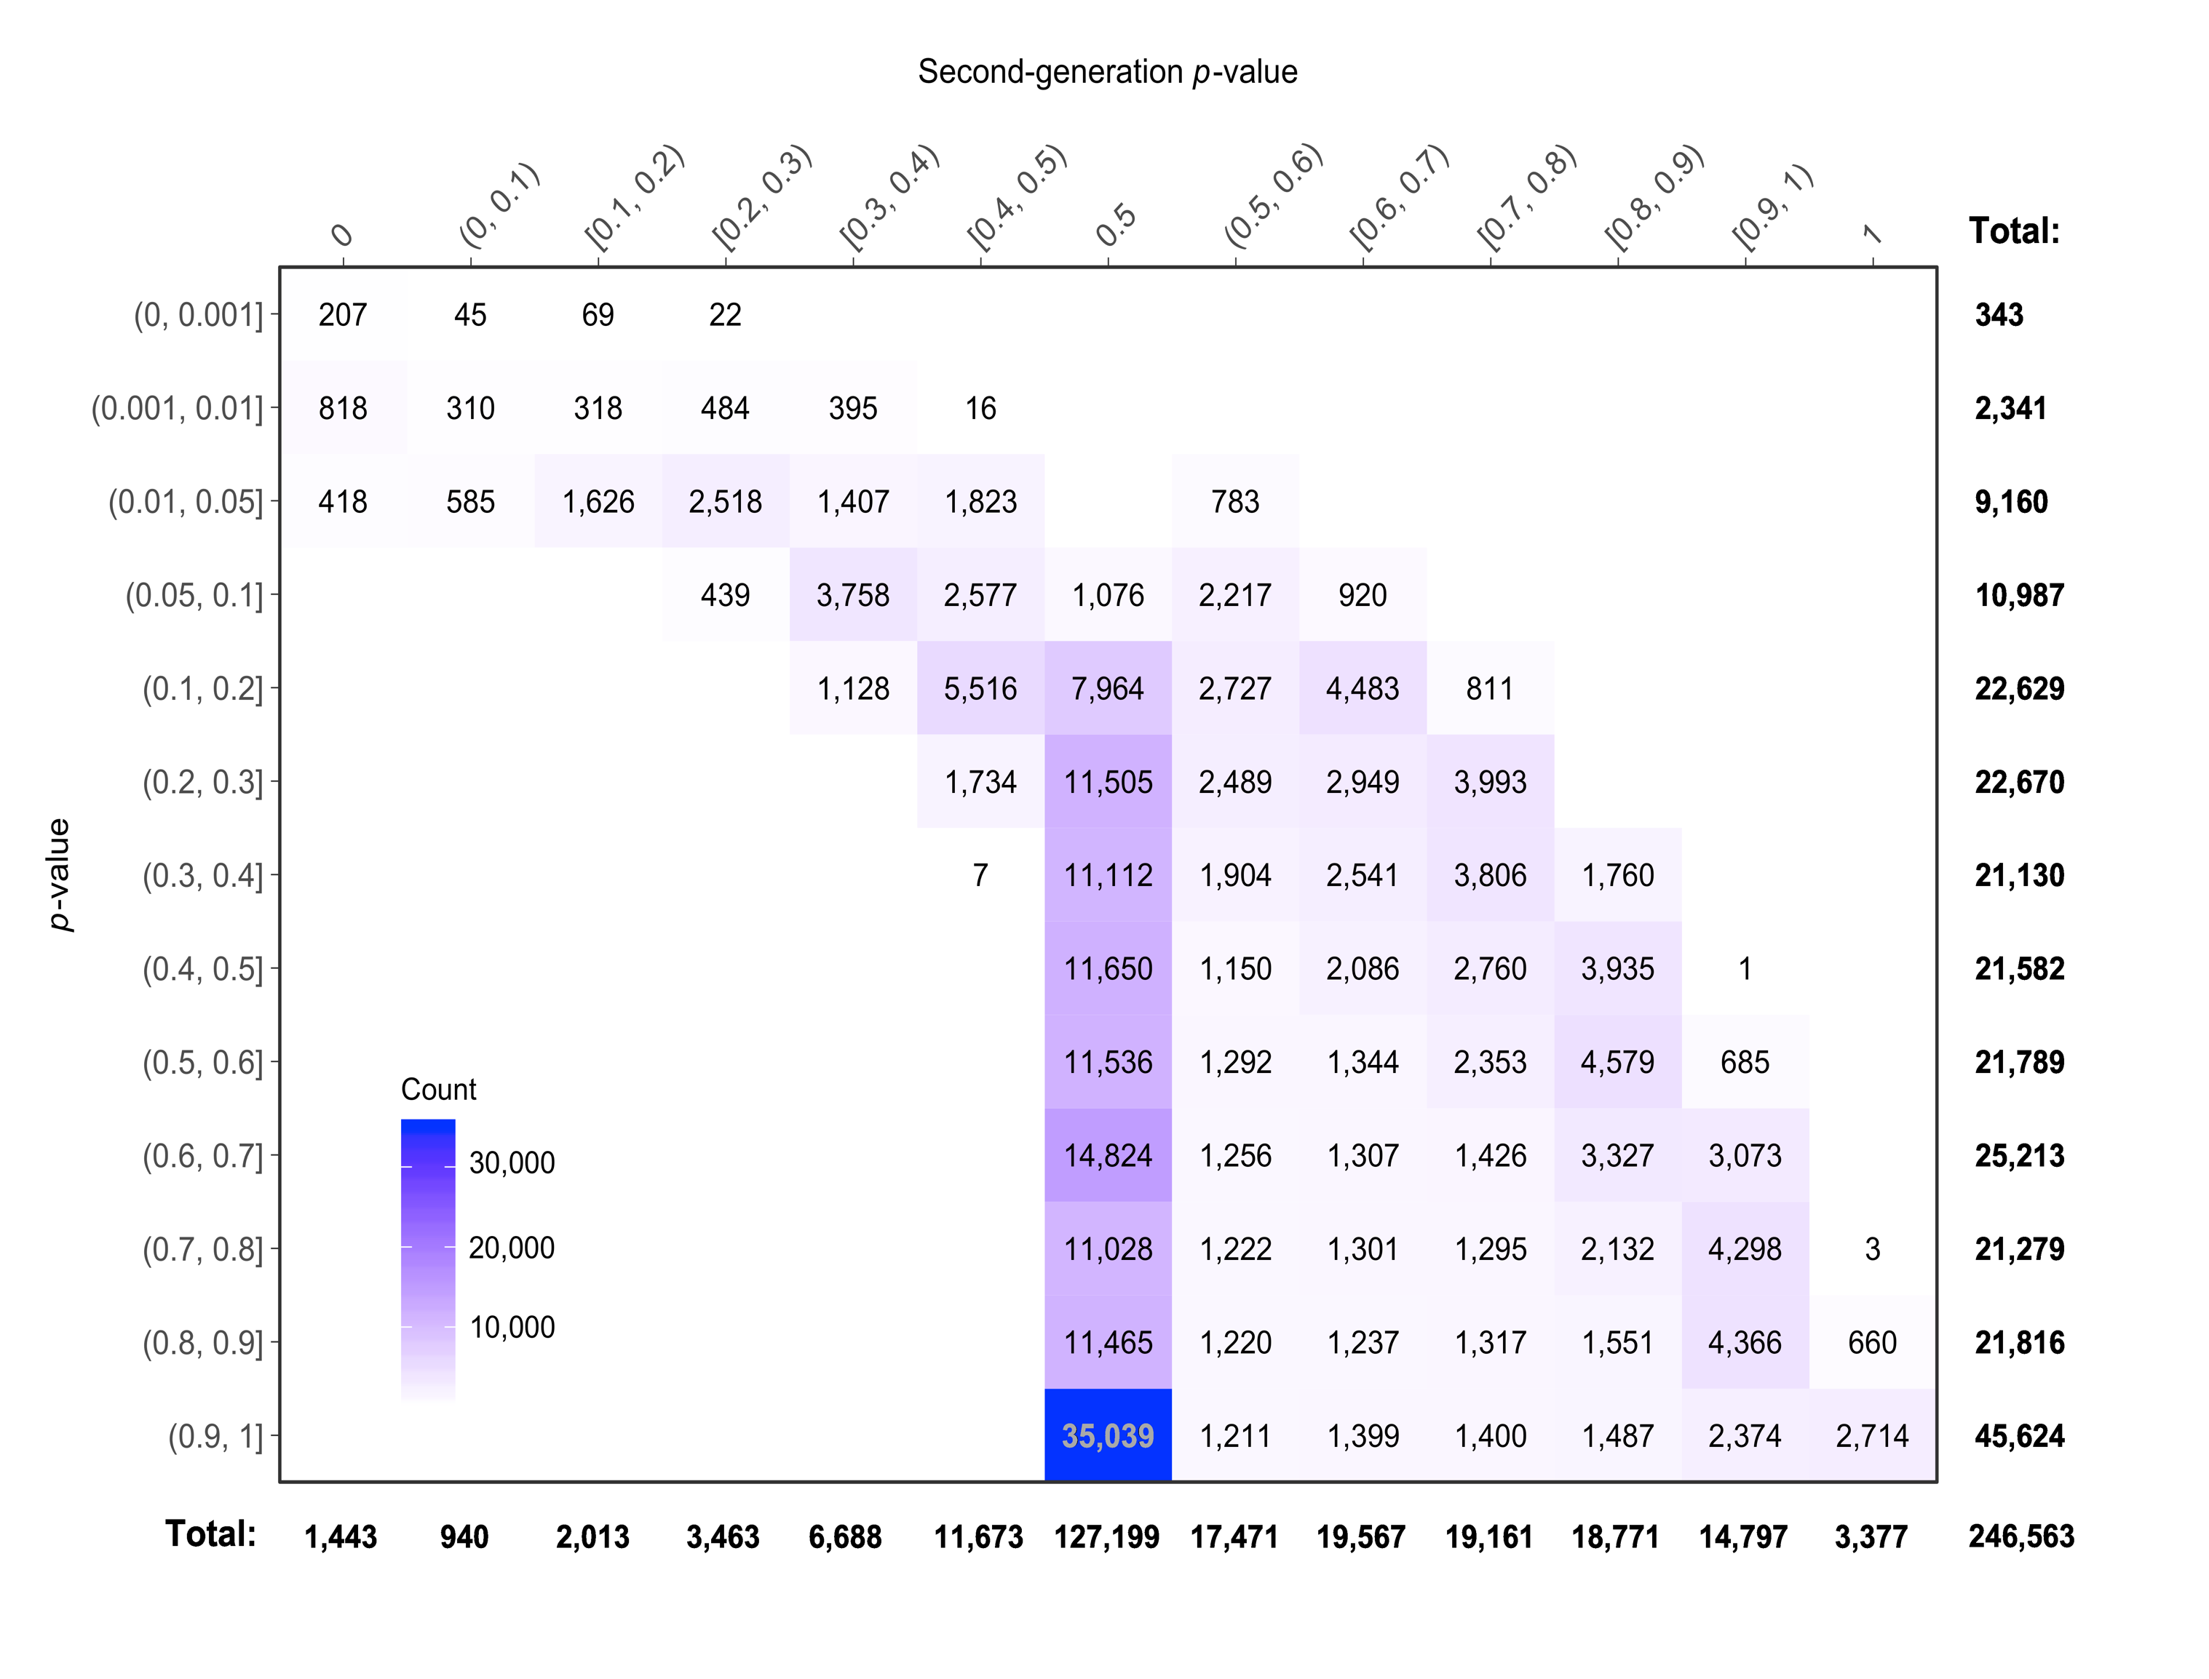
p-value

Slide 58
Coding Example Here
Appendix of plos one – does r2 change example?

Slide 59
Now go to second ppt.

Slide 60
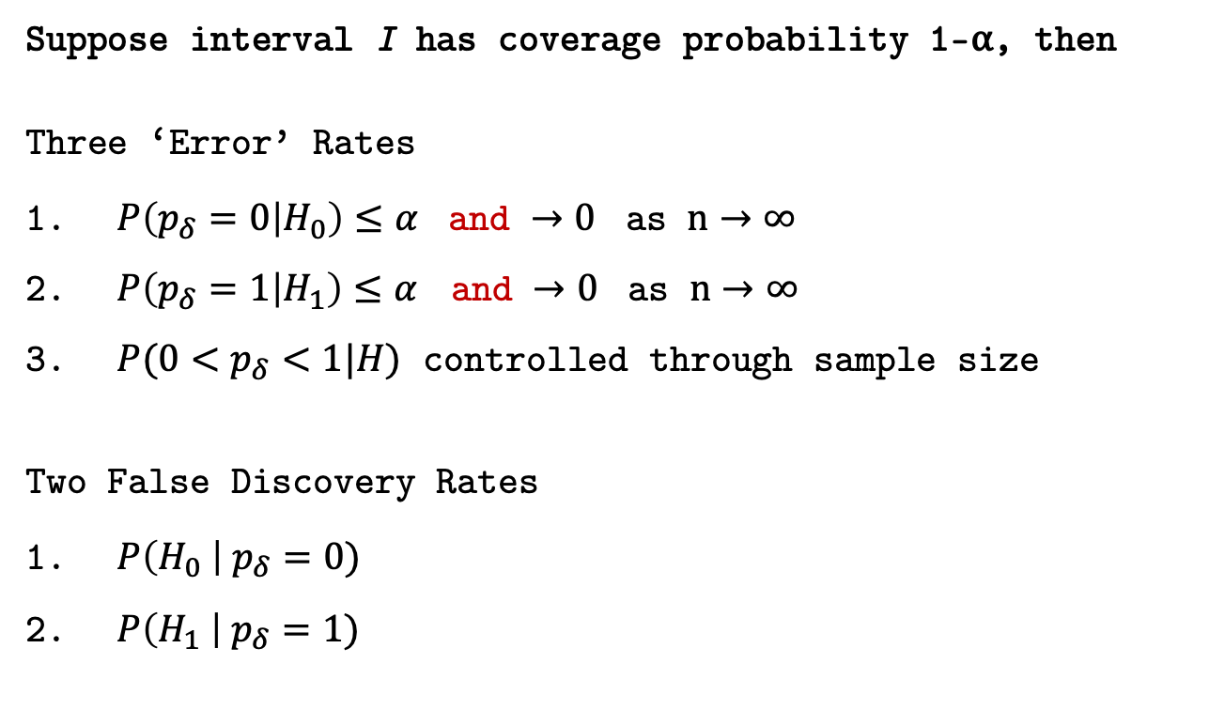
Statistical Properties
Suppose interval I has coverage probability 1-⍺, then
Three ‘Error’ Rates
$P\left(p_{δ}=0 | H_{0}\right)≤α$ and $→0$ as $n→∞$
$P\left(p_{δ}=1 | H_{1}\right)≤α$ and $→0$ as $n→∞$
$P(0<p_{δ}<1|H)$ controlled through sample size
Two False Discovery Rates
$P\left(H_{0} \right| p_{δ}=0)$
$P\left(H_{1} \right| p_{δ}=1)$
Will examine in next module
Will illustrate in next module

Slide 61
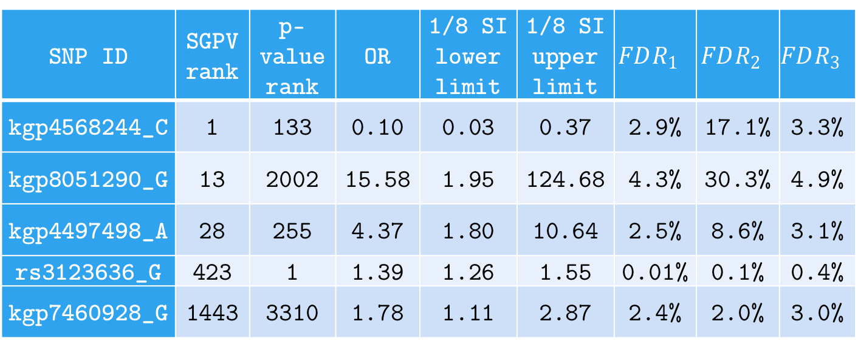
False Discovery Rates
FDR for 5 SGPV=0 findings; computed under various null and alternative configurations (w/ flat prior).
SNP ID | SGPV rank | p-value rank | OR | 1/8 SI lower limit | 1/8 SI upper limit | $$FDR_{1}$$ | $$FDR_{2}$$ | $$FDR_{3}$$
kgp4568244_C | 1 | 133 | 0.10 | 0.03 | 0.37 | 2.9% | 17.1% | 3.3%
kgp8051290_G | 13 | 2002 | 15.58 | 1.95 | 124.68 | 4.3% | 30.3% | 4.9%
kgp4497498_A | 28 | 255 | 4.37 | 1.80 | 10.64 | 2.5% | 8.6% | 3.1%
rs3123636_G | 423 | 1 | 1.39 | 1.26 | 1.55 | 0.01% | 0.1% | 0.4%
kgp7460928_G | 1443 | 3310 | 1.78 | 1.11 | 2.87 | 2.4% | 2.0% | 3.0%
Notes:
For illustration, we computed several flavors of the FDR for 5 SNPs with a SGPV of 0. These are displayed in Table 2. Three versions of the false discovery rate, $FDR=P\left(H_{0} | p_{δ}=0\right)$, were computed. Here $θ$ is the log odds ratio and $\hat{θ}$ is its MLE. $FDR_{1}$ uses the natural point null, $H_{0}:θ=\log\left(1\right)$ with the alternative set to the MLE, $H_{1}:θ=\hat{θ}$. $FDR_{2}$ uses a point null hypothesis that is closer to the null boundary, $H_{0}:θ=\log\left(1.05\right)$, with a prespecified alternative $H_{1}:θ=\log\left(2\right)$. $FDR_{3}$ uses the interval null $H_{0}:θ\sim unif\left[\log\left(0.9\right), \log\left(1/0.9\right)\right]$ and the interval alternative $H_{1}:θ\sim unif\left[{\hat{θ}}_{l},{\hat{θ}}_{u}\right]$ where ${\hat{θ}}_{l}$ and ${\hat{θ}}_{u}$ are the lower and upper bound of the 1/8 SI. FDR computations follow the formulae in Section 5 and Remark E.

Slide 62
Remarks
ASA SGPV Short Course…
Indicate compatibility with null or alternative
Indicate when the data are inconclusive (!)
Straightforward to compute and interpret
Controls error rate using science
Reduces the false discovery rate
Anchoring the scale of the effect size…
Eliminates most Type I Errors
Improves scientific translation of statistical model

Slide 63
Acknowledgements
Outrageous Claim (!?)
The SGPV achieves the inferential properties that many scientists hope, or believe, are attributes of the classic p-value.
Collaborators
William D. Dupont
Robert A. Greevy
Lucy D’Agostino McGowan
Valerie Welty
Jeffrey R. Smith
Website / Papers / Code
statisticalevidence.com
PLOS One ; TAS (In Press)
Google “Second-Generation p-value”
devtools::install_github("weltybiostat/sgpv")

